Slide 1

STRONGBOX: CONFIDENTIALITY, INTEGRITY, AND PERFORMANCE USING STREAM CIPHERS FOR FULL DRIVE ENCRYPTION
Bernard Dickens III Ariel J. Feldman Haryadi S. Gunawi Henry Hoffmann

Slide 2



Full DRIVE (DISK) Encryption?

Slide 3
Full DRIVE (DISK) Encryption?
Industry Standard: AES-XTS

Slide 4
AES Block Cipher In XTS Mode
AES is a block cipher

Slide 5

AES Block Cipher In XTS Mode
AES is a block cipher
Inspired by traditional spinning disk storage

Slide 6

AES Block Cipher In XTS Mode
AES is a block cipher
Inspired by traditional spinning disk storage
Problem: AES-XTS is SLOW
DATA
AES-XTS
DATA
DATA

Slide 7
AES Block Cipher In XTS Mode
AES is a block cipher
Inspired by traditional spinning disk storage
Problem: AES-XTS is SLOW
Cause: narrow AES “blocks,” wide disk sectors
DISK SECTOR

Slide 8
AES Block Cipher In XTS Mode
AES is a block cipher
Inspired by traditional spinning disk storage
Problem: AES-XTS is SLOW
Cause: narrow AES “blocks,” wide disk sectors
DISK SECTOR

Slide 9
AES Block Cipher In XTS Mode
AES is a block cipher
Inspired by traditional spinning disk storage
Problem: AES-XTS is SLOW
Cause: narrow AES “blocks,” wide disk sectors
DISK SECTOR

Slide 10
AES Block Cipher In XTS Mode
AES is a block cipher
Inspired by traditional spinning disk storage
Problem: AES-XTS is SLOW
Cause: narrow AES “blocks,” wide disk sectors
DISK SECTOR

Slide 11
AES Block Cipher In XTS Mode
AES is a block cipher
Inspired by traditional spinning disk storage
Problem: AES-XTS is SLOW
Cause: narrow AES “blocks,” wide disk sectors
DISK SECTOR

Slide 12
AES Block Cipher In XTS Mode
AES is a block cipher
Inspired by traditional spinning disk storage
Problem: AES-XTS is SLOW
Cause: narrow AES “blocks,” wide disk sectors
DISK SECTOR
FINALLY DONE!

Slide 13
not The Only Cipher In Town
Stream ciphers are also a thing

Slide 14
not The Only Cipher In Town
Stream ciphers are also a thing
Data encrypted via XOR as a continuous stream
Your Data:
1
1
1
0
0
1
0
0
⊕
Keystream:
0
1
0
0
1
1
0
1
=
Encrypted:

Slide 15
not The Only Cipher In Town
Stream ciphers are also a thing
Data encrypted via XOR as a continuous stream
Stream ciphers are FAST
Cause: XOR operation is simple, fast
Your Data:
1
1
1
0
0
1
0
0
⊕
Keystream:
0
1
0
0
1
1
0
1
=
Encrypted:

Slide 16

Switch Ciphers, Problem Solved?

Slide 17
Big Problems with Stream Ciphers
There are two big problems with using stream ciphers for FDE:

Slide 18
Big Problems with Stream Ciphers
There are two big problems with using stream ciphers for FDE:
Data confidentiality can be trivially violated with overwrites

Slide 19
Big Problems with Stream Ciphers
There are two big problems with using stream ciphers for FDE:
Data confidentiality can be trivially violated with overwrites
Rolling back the system to a previously valid state also leads to confidentiality violations

Slide 20
Overwrites Are a Big Deal
Why are overwrites such a problem?
Overwrites violate confidentiality
Rollbacks lead to overwrites

Slide 21

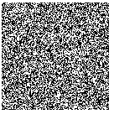
Overwrites Are a Big Deal
Why are overwrites such a problem?
Your Data:
Keystream:
Overwrites violate confidentiality
Rollbacks lead to overwrites

Slide 22


Overwrites Are a Big Deal
Why are overwrites such a problem?
Your Data:
⊕ =>
Keystream:
Encrypted
Overwrites violate confidentiality
Rollbacks lead to overwrites

Slide 23

Overwrites Are a Big Deal
Why are overwrites such a problem?
Your Data:
(the same)
Keystream:
Overwrites violate confidentiality
Rollbacks lead to overwrites

Slide 24


Overwrites Are a Big Deal
Why are overwrites such a problem?
Your Data:
⊕ =>
(the same)
Encrypted?
Keystream:
Overwrites violate confidentiality
Rollbacks lead to overwrites

Slide 25
Overwrites Are a Big Deal
Why are overwrites such a problem?
Original Write:
d’ ⊕ pad = c’
(i.e. same keystream)
Overwrite:
Overwrites violate confidentiality
Rollbacks lead to overwrites

Slide 26


Overwrites Are a Big Deal
Why are overwrites such a problem?
Original Write:
d’ ⊕ pad = c’
⊕ =>
(i.e. same keystream)
ENCRYPTION BROKEN!
Overwrite:
Overwrites violate confidentiality
Rollbacks lead to overwrites

Slide 27
Overwrites Are a Big Deal
Why are overwrites such a problem?
The solution: “rekey” the keystream on every overwrite
Overwrites violate confidentiality
Rollbacks lead to overwrites

Slide 28
Overwrites Are a Big Deal
Why are overwrites such a problem?
The solution: “rekey” the keystream on every overwrite
Another problem: rekeying is expensive!
Overwrites violate confidentiality
Rollbacks lead to overwrites

Slide 29
Overwrites Are a Big Deal
Why are overwrites such a problem?
The solution: “rekey” the keystream on every overwrite
Another problem: rekeying is expensive!
Out of ~17,000 write ops, EXT4 makes ~10,000 overwrites
10,000 x expensive operation = performance degradation
This expense negates perf benefit of the stream cipher
Overwrites violate confidentiality
Rollbacks lead to overwrites

Slide 30

ROLLBACKs Are Compromising
Rollbacks are even worse!
Overwrites violate confidentiality
Rollbacks lead to overwrites

Slide 31
ROLLBACKs Are Compromising
Rollbacks are even worse!
Take a snapshot of the system at valid state
Overwrites violate confidentiality
Rollbacks lead to overwrites

Slide 32
ROLLBACKs Are Compromising
Rollbacks are even worse!
Take a snapshot of the system at valid state
Rollback the system to a previous valid state
Overwrites violate confidentiality
Rollbacks lead to overwrites

Slide 33
ROLLBACKs Are Compromising
Rollbacks are even worse!
Take a snapshot of the system at valid state
Rollback the system to a previous valid state
Allow writes as normal
Overwrites violate confidentiality
Rollbacks lead to overwrites

Slide 34
ROLLBACKs Are Compromising
Rollbacks are even worse!
Take a snapshot of the system at valid state
Rollback the system to a previous valid state
Allow writes as normal
Contrast (XOR) encrypted snapshot with current “encrypted” state
SAME AS AN OVERWRITE!
Overwrites violate confidentiality
Rollbacks lead to overwrites

Slide 35

No!
You can only use
a block cipher for
Full Drive
Encryption!

Slide 36
The Old Assumption
Stream ciphers are faster…
… but the overhead of dealing with overwrites and rollbacks negates any potential perf benefit
Hence, AES-XTS is the industry standard

Slide 37
the Old Assumption: Invalidated
Key insight: two technology trends invalidate old assumption

Slide 38
the Old Assumption: Invalidated
Key insight: two technology trends invalidate old assumption
Non-volatile flash memory as secondary storage
Governed by Flash Translation Layer (FTL)
FTL tends to avoid overwriting same cells (wear-leveling)

Slide 39
the Old Assumption: Invalidated
Key insight: two technology trends invalidate old assumption
Non-volatile flash memory as secondary storage
Governed by Flash Translation Layer (FTL)
FTL tends to avoid overwriting same cells (wear-leveling)
Proliferation of secure hardware
TPM/TEE implemented by nearly all computer and mobile device manufacturers
Secure hardware allows us to actively version system state and detect rollbacks

Slide 40
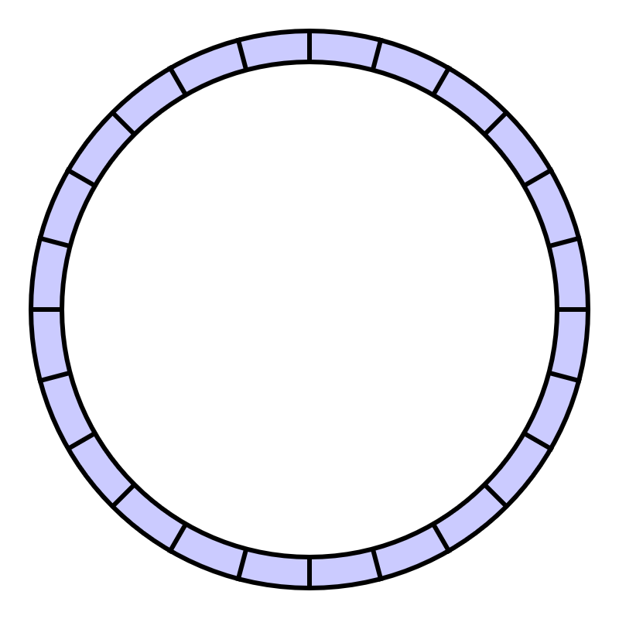
FTL <=> LFS
FTL operates like a Log-structured File System (LFS)
FTL = LFS = append-only writes
(naturally avoids overwrites)

Slide 41
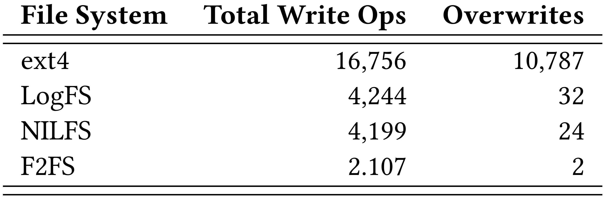
LFSes Make Few Overwrites

Slide 42

Actively Versioning System State
TPM/TEE allows us to actively version system state

Slide 43
Actively Versioning System State
TPM/TEE allows us to actively version system state
Accomplished with fast secure monotonic counters

Slide 44
Actively Versioning System State
TPM/TEE allows us to actively version system state
Accomplished with fast secure monotonic counters
These hardware counters cannot be rolled back!

Slide 45

The Grand Solution
Leveraging the trends, we propose StrongBox
A drop-in replacement for AES-backed FDE providers such as dm-crypt
Uses a stream cipher instead of the AES-XTS block cipher
Uses an LFS to avoid overwrites and rekeying penalties
Uses secure monotonic counters to prevent rollbacks

Slide 46
Threat Model
Confidentiality
dm-crypt (AES-XTS): AES block cipher
StrongBox: ChaCha20 stream cipher

Slide 47
Threat Model
Confidentiality
dm-crypt (AES-XTS): AES block cipher
StrongBox: ChaCha20 stream cipher
Overwrites (many-time pad)
dm-crypt (AES-XTS): N/A
StrongBox: append-only write property of FTL/LFS

Slide 48
Threat Model (continued)
Rollbacks
dm-crypt (AES-XTS): N/A
StrongBox: secure monotonic counters

Slide 49
Threat Model (continued)
Rollbacks
dm-crypt (AES-XTS): N/A
StrongBox: secure monotonic counters
Integrity
dm-crypt (AES-XTS): hopefully the user is paying attention
StrongBox: hashing scheme to tie system state to counter

Slide 50
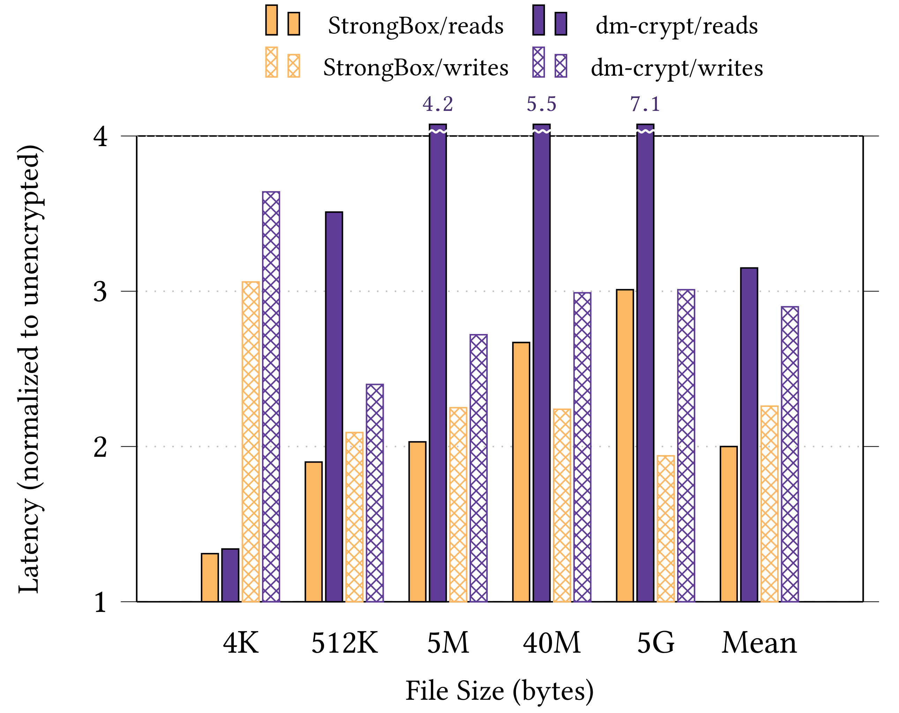
Performance Win
By harmonic mean:
1.7x faster reads
1.3x faster writes
Experimental setup:
Odroid XU3 ARM big.LITTLE system
eMMC 5.0HS400 backing store

Slide 51
Hardware Accelerated AES?
What about hardware support for AES (i.e. AES-NI?)

Slide 52
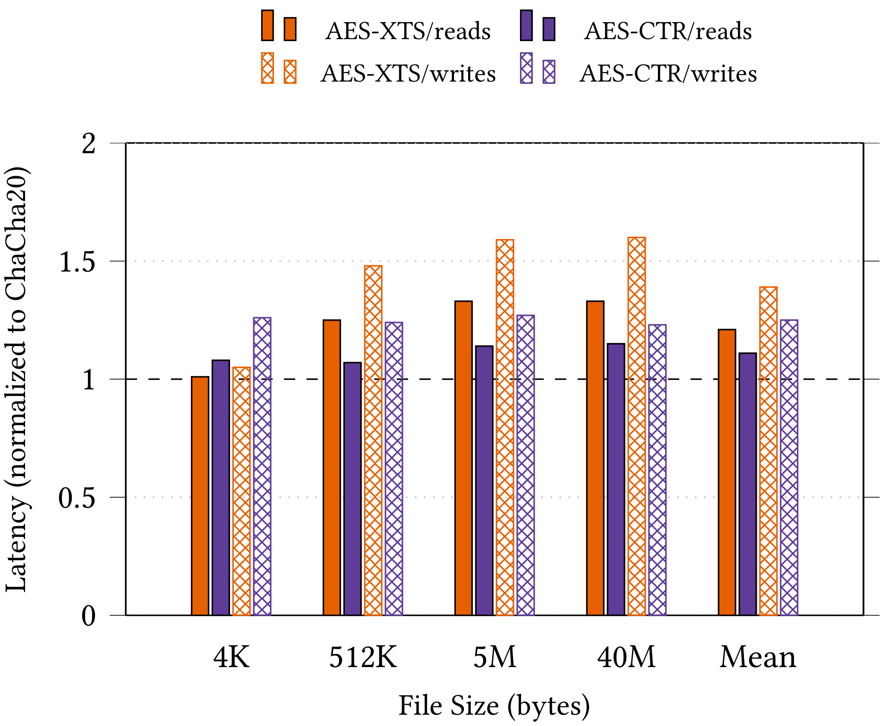
AES Block Cipher In CTR Mode

Slide 53
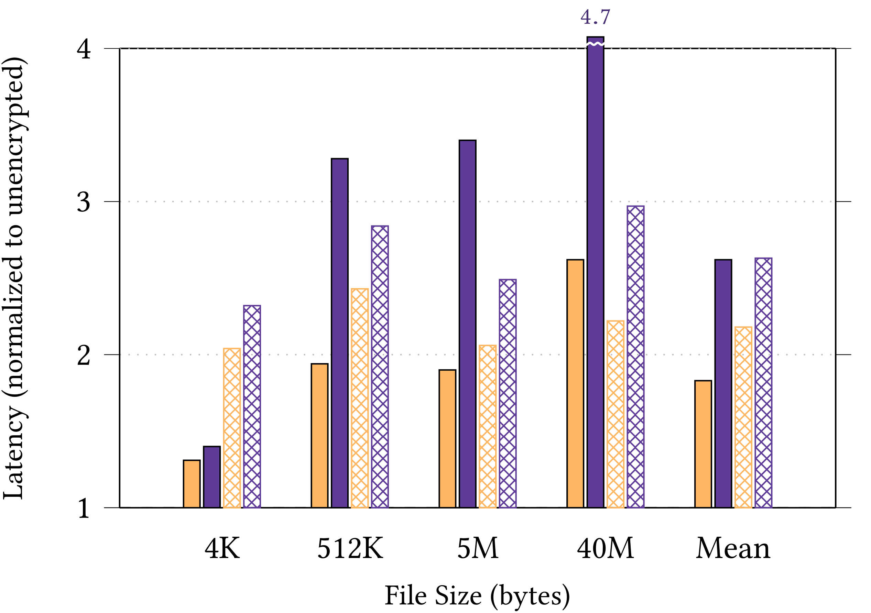
Random IO

Slide 54
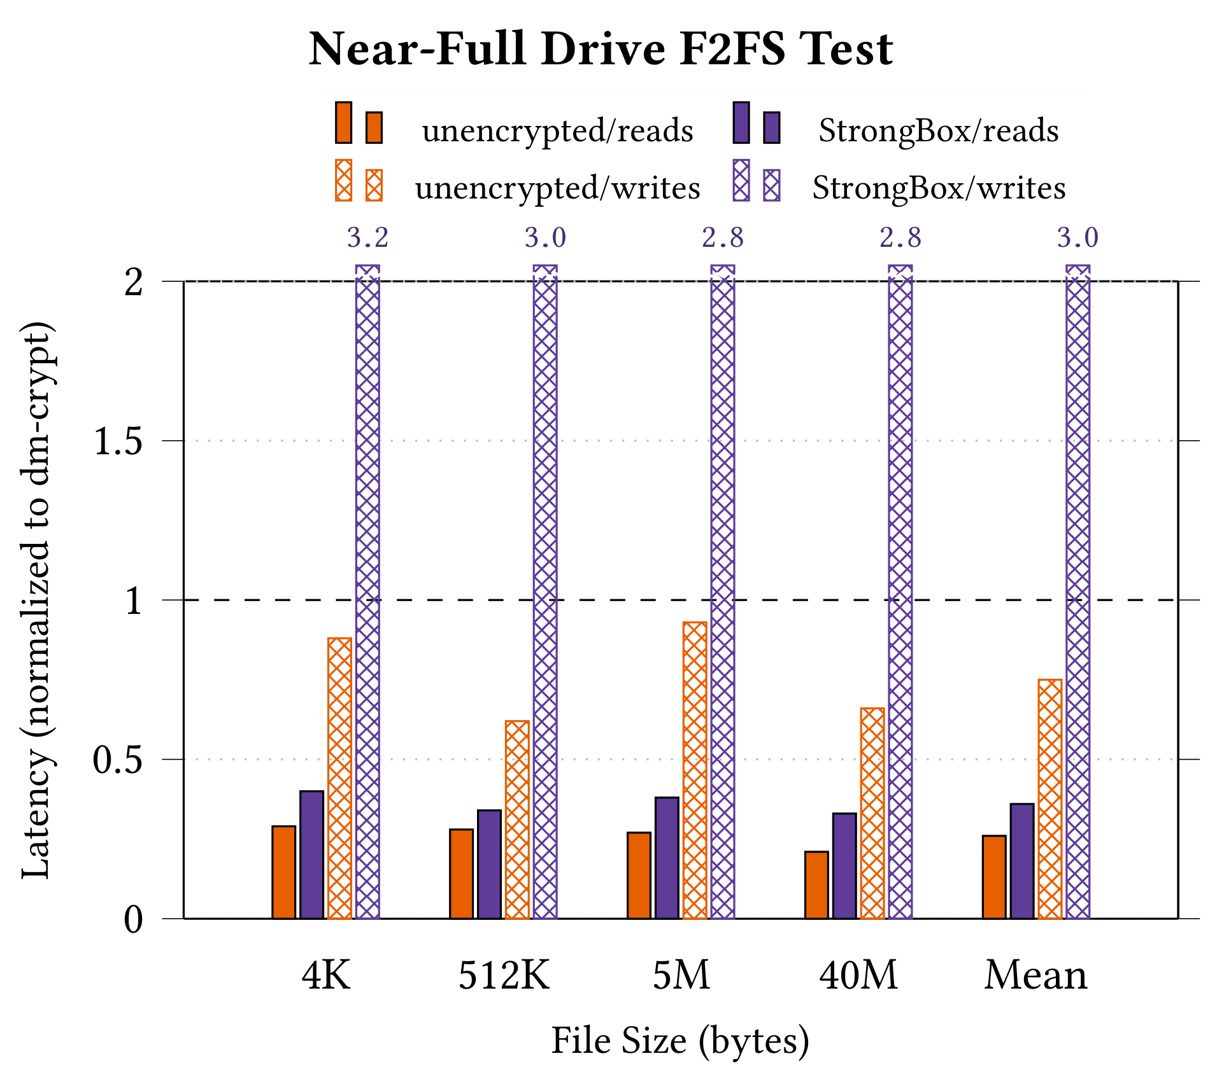
Fullness Tests

Slide 55
F2FS Deep Integration
More headroom to exploit?
There is data duplication between StrongBox and F2FS!
Explore: F2FS dirty writes vs StrongBox dirty flake state
F2FS and StrongBox metadata synchronization
Goal: even further reduction in SB’s observed overwrites
Offload integrity concerns to F2FS?
Goal: reduce/eliminate Merkle Tree memory footprint
Can F2FS and StrongBox coordinate when storage is near full?
Goal: reduce/eliminate write slowdown with near-full drive

Slide 56
Cipher Stream Swapping
✔ Implement StrongBox cipher abstraction layer
✔ Integrate eStream profile 1 cipher suite into StrongBox
✔ Tightly integrate energy monitoring tools into StrongBox
✔ Clearly identify sec and perf tradeoffs between ciphers
--- Clearly identify energy/power tradeoffs between ciphers
We’re seeing some “interesting” behavior…
✔ Fully implement offline cipher switching with StrongBox
--- Fully implement online cipher switching with StrongBox
--- Explore potential configuration demands/use case scenarios depending on energy/power, sec, and perf tradeoffs

Slide 57
Questions?
Bernard Dickens III Ariel J. Feldman Haryadi S. Gunawi Henry Hoffmann
https://git.xunn.io/research/buselfs-public

